Slide 1
D3 Data Visualisation
Jacob Stenton

Slide 2
The Data
United Kingdom GDP (£)
United Kingdom Energy Usage (PJ)

Slide 3
Method
HTML, CSS, JavaScript, D3
Two data sheets – GDP & Energy
Data from XLSX spreadsheet converted to CSV file (manual)
Data read from CSVs plotted in D3 graph

Slide 4
Graph plan

Slide 5
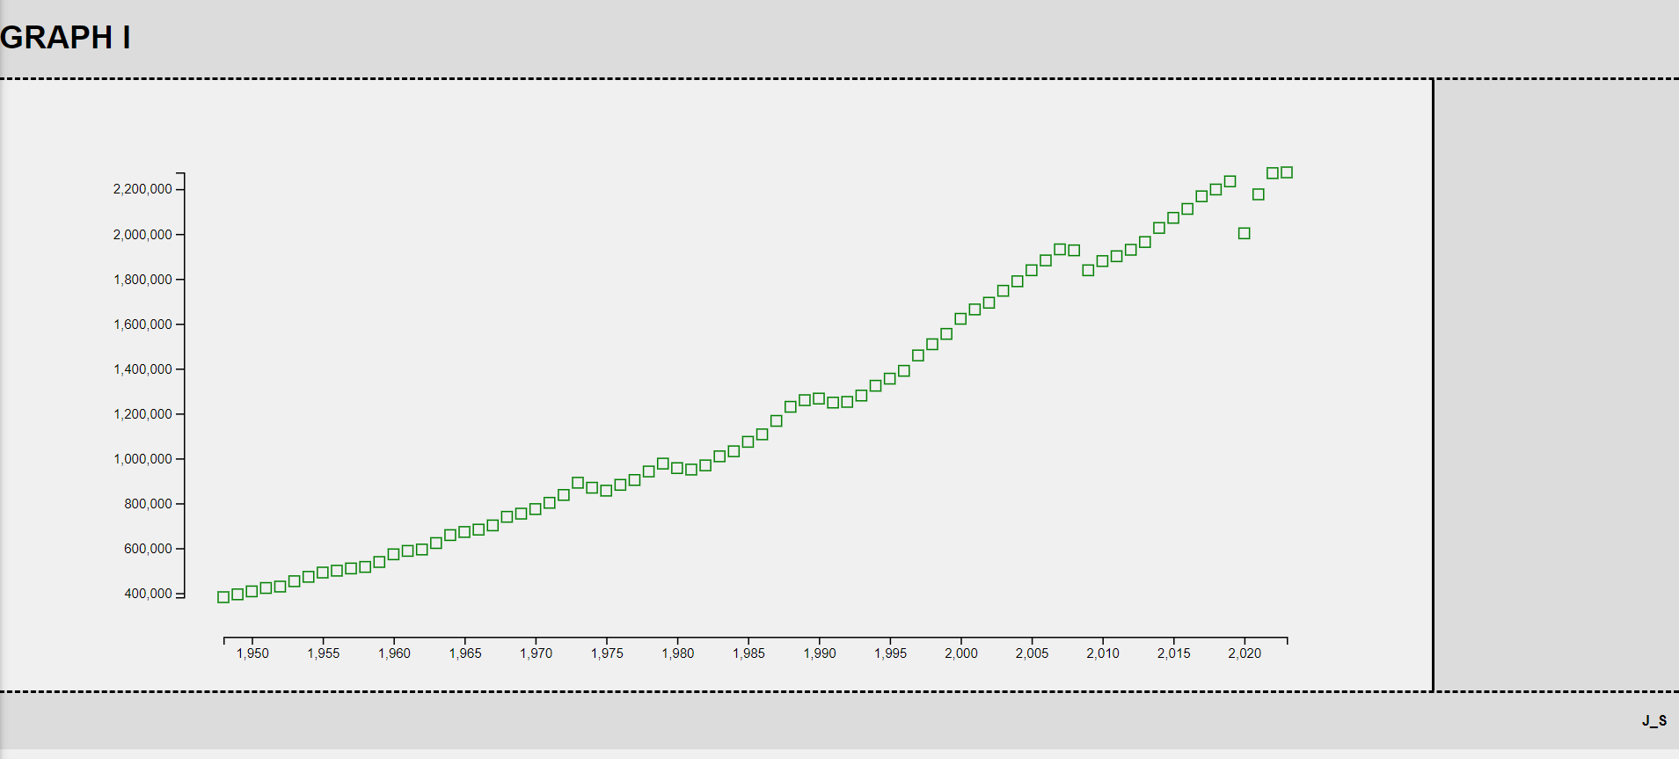
So far…
https://git.arts.ac.uk/21026540/Visualisation-Sensing

